Slide 1
Debian 8
Downloading and installing
Debian 8.0.0 live non-free
Presentation at Waikato Linux User Group
25 May 2015
Ian Stewart

Slide 2
Debian
Initial release: 1993 ~ 21 years ago
Latest release: 8.0 (Jessie). April 2015
Previous release: 7.0~7.8 (Wheezy) May 2013
GNU/Linux operating system
Desktops: Gnome, KDE, Xfce, LXDE, Cinnamon, MATE.
Also Gui-less “Standard” system
Package manager: dpkg

Slide 3
Debian 8
Architecture Official ports
As of the Jessie release, the official ports are:
amd64: x86-64
arm64: ARMv8-A architecture
armel: Little-endian ARM (ARMv4T)
armhf: ARM hard-float (ARMv7)
i386: IA-32
mips: Big-endian MIPS
mipsel: Little-endian MIPS
powerpc: PowerPC
ppc64el: Little-endian PowerPC64
s390x: z/Architecture with 64-bit
12 unofficial ports DEC Alpha, PA-RISC

Slide 4
Debian 8
Traditional Installation:
Use Debian Installer on a release medium (such as a CD) and use it to install the desired set of packages, either from the same medium or via a network.
There are alternatives such as booting from a network or installing from within an existing system using Debootstrap.
There are over 30 CDs (or 5 DVDs) in a full set, only the first CD is required to install Debian. The additional CDs are optional and include extra packages, that can be downloaded individually during the installation, or later.

Slide 5
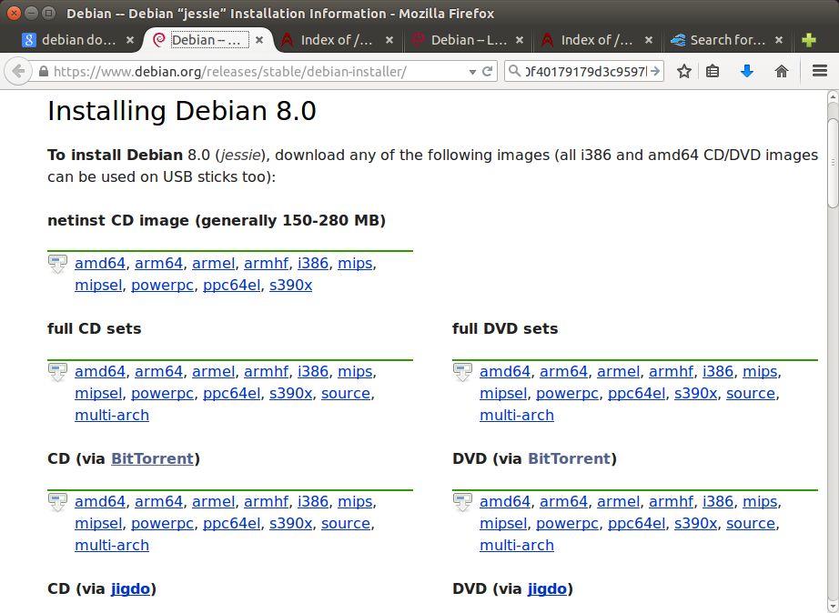
Debian 8

Slide 6
Debian 8 – Live Systems Project
http://live.debian.net/
The Live Systems project maintains the components to build Debian based Live systems and the official Debian Live images themselves.
A Debian Live system is a Debian operating system that does not require a classical installer to use it.
Although the Live Systems project is about the tools to create your own customized Live system, we offer some prebuilt images.
Commenced live iso's Debian 5.0 February 2009

Slide 7
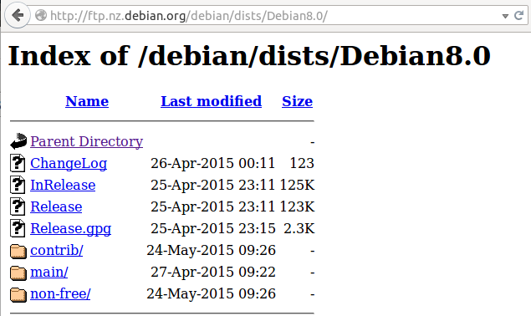
Debian 8 - Live
Philosophy:
We will only use packages from the Debian repository in the "main" section. The non-free section is not part of Debian and therefore cannot be used for official live system images.

Slide 8
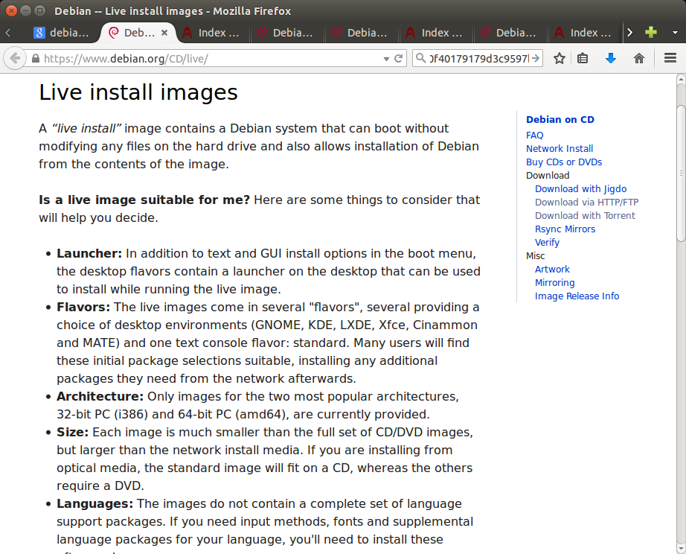
Debian 8 - Live

Slide 9
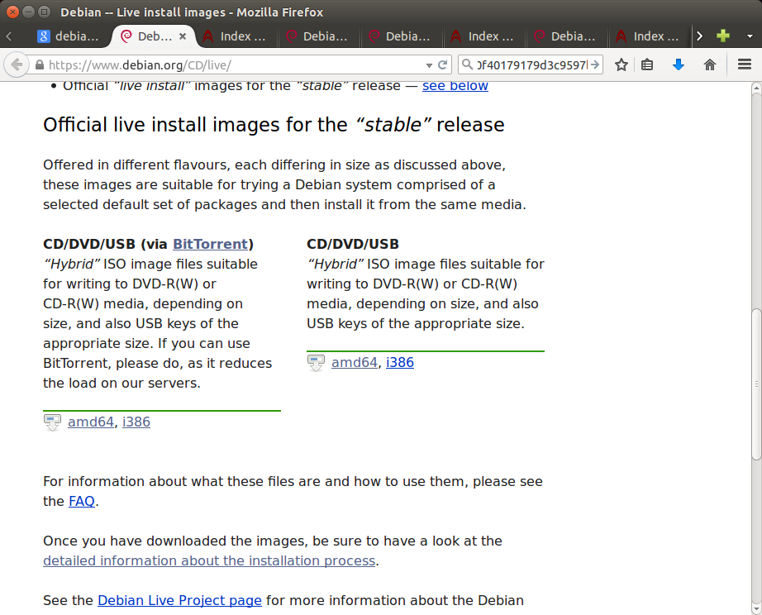
Debian 8 – Live
Download Method: Bit Torrent or iso image ?

Slide 10
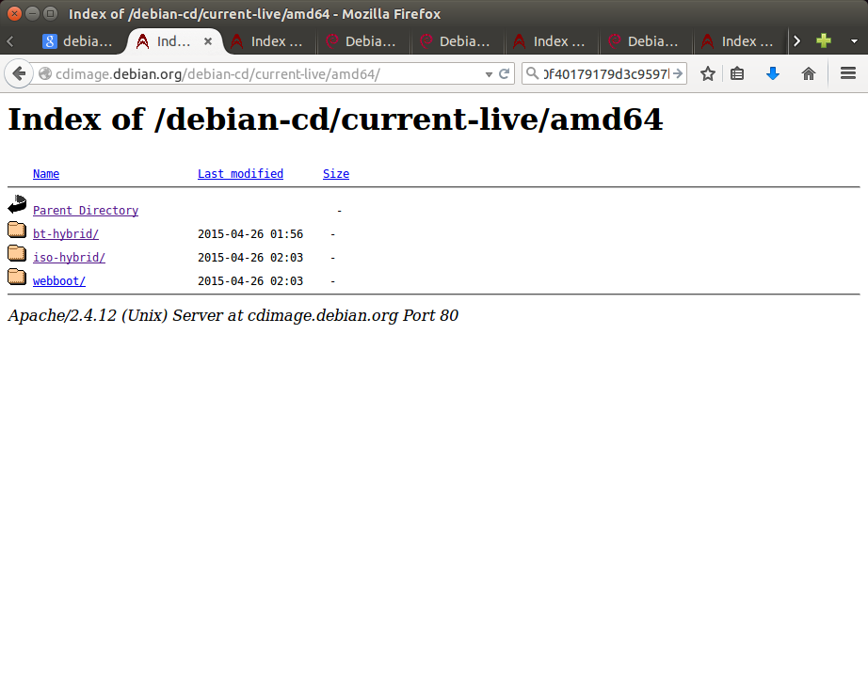
Debian 8 – Live
Download Method: Bit Torrent or iso image

Slide 11
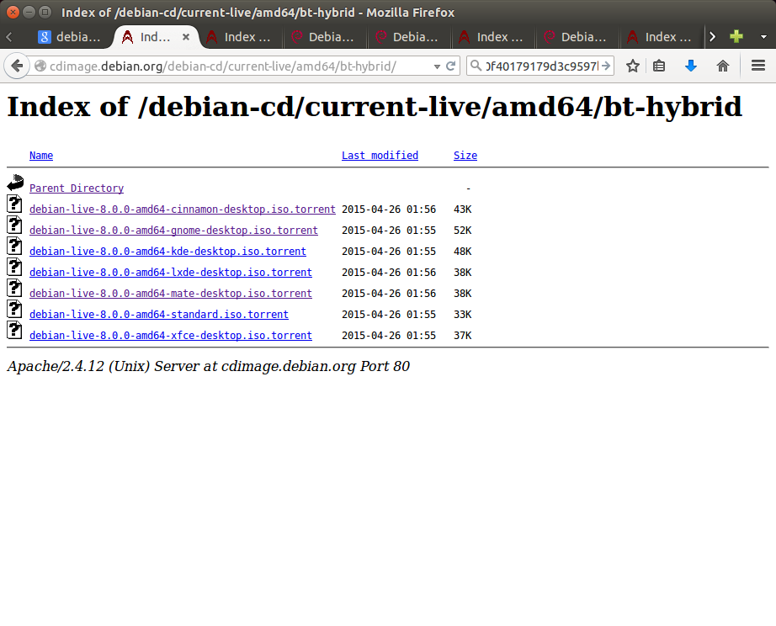
Debian 8 – Live
Download using BitTorrent

Slide 12
Debian 8 – Live
Potential Problem...
Debian Live images do not contain the “non-free” firmware packages. For example there is a good chance that your wireless lan adapter will not work as its firmware is not available to be loaded.
Solution...
Debian Live + non-free iso binary images
(even though they are “unofficial”) http://cdimage.debian.org/cdimage/unofficial/non-free/

Slide 13
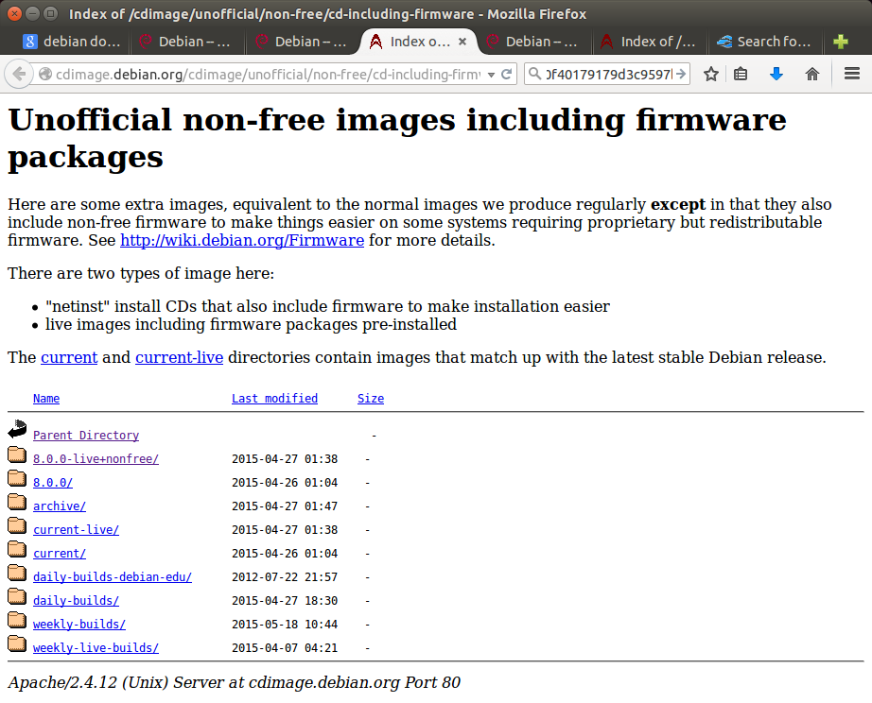
Debian 8 – Live Unofficial Non-Free http://cdimage.debian.org/cdimage/unofficial/non-free/cd-including-firmware/

Slide 14
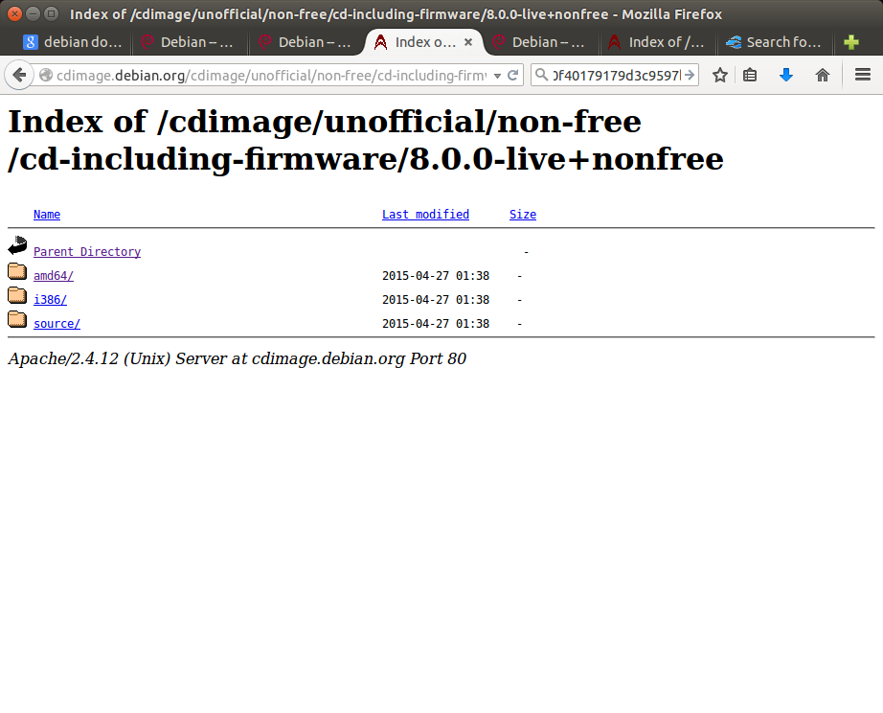
Debian 8 – Live Unofficial Non-Free

Slide 15
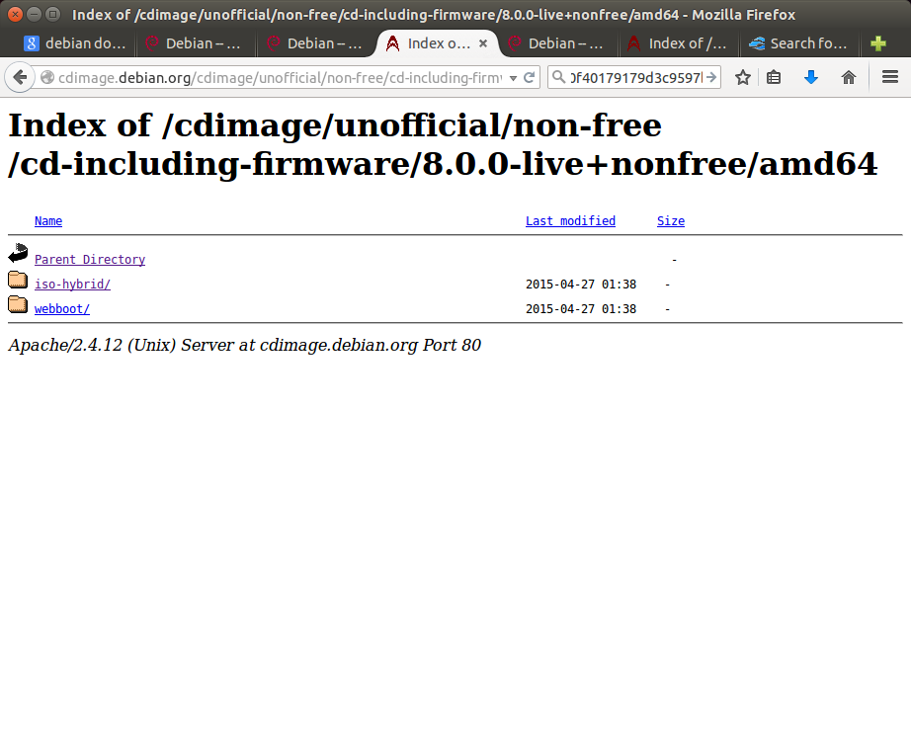
Debian 8 – Live Unofficial Non-Free

Slide 16
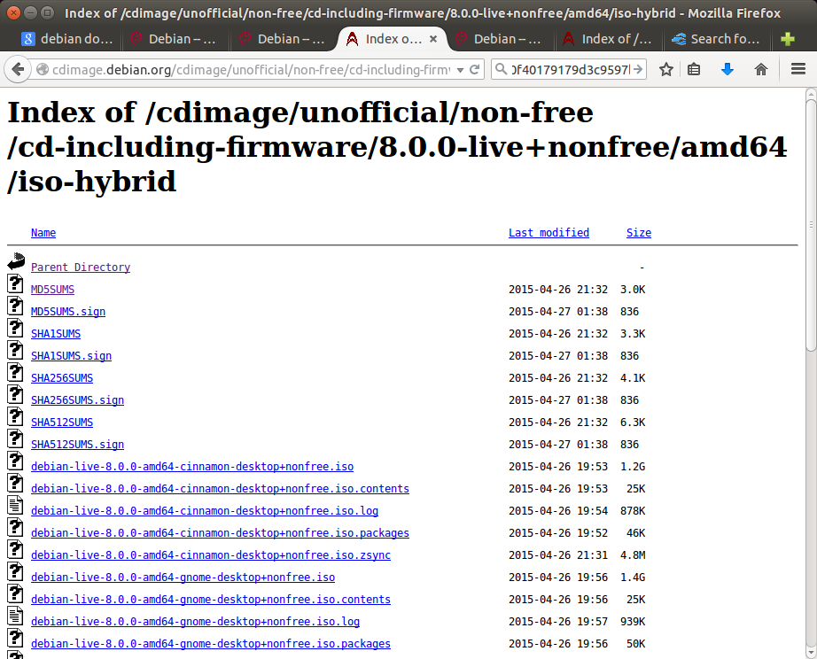
Debian 8 – Live Unofficial Non-Free
(No BitTorrent)

Slide 17
Debian 8 – Live Unofficial Non-Free Download – Don't use Firefox – Break connection no restart.
Instead use wget -c ...
$ wget -c http://cdimage.debian.org/cdimage/unofficial/non-free/cd-including-firmware/8.0.0-live+nonfree/amd64/iso-hybrid/debian-live-8.0.0-amd64-kde-desktop+nonfree.iso

Slide 18
Debian 8 – Live Unofficial Non-Free
Download –Using wget -c (try = 1)
~/Downloads$ wget -c http://cdimage.debian.org/cdimage/unofficial/non-free/cd-including-firmware/8.0.0-live+nonfree/amd64/iso-hybrid/debian-live-8.0.0-amd64-kde-desktop+nonfree.iso
--2015-05-22 17:00:50-- http://cdimage.debian.org/cdimage/unofficial/non-free/cd-including-firmware/8.0.0-live+nonfree/amd64/iso-hybrid/debian-live-8.0.0-amd64-kde-desktop+nonfree.iso
Resolving cdimage.debian.org (cdimage.debian.org)... 130.239.18.165, 130.239.18.173, 2001:6b0:e:2018::165, ...
Connecting to cdimage.debian.org (cdimage.debian.org)|130.239.18.165|:80... connected.
HTTP request sent, awaiting response... 302 Found
Location: http://caesar.acc.umu.se/cdimage/unofficial/non-free/cd-including-firmware/8.0.0-live+nonfree/amd64/iso-hybrid/debian-live-8.0.0-amd64-kde-desktop+nonfree.iso [following]
--2015-05-22 17:00:51-- http://caesar.acc.umu.se/cdimage/unofficial/non-free/cd-including-firmware/8.0.0-live+nonfree/amd64/iso-hybrid/debian-live-8.0.0-amd64-kde-desktop+nonfree.iso
Resolving caesar.acc.umu.se (caesar.acc.umu.se)... 130.239.18.142, 2001:6b0:e:2018::142
Connecting to caesar.acc.umu.se (caesar.acc.umu.se)|130.239.18.142|:80... connected.
HTTP request sent, awaiting response... 200 OK
Length: 1402404864 (1.3G) [application/x-iso9660-image]
Saving to: ‘debian-live-8.0.0-amd64-kde-desktop+nonfree.iso’
100%[====================================>] 1,402,404,864 349KB/s in 4h 5m
2015-05-22 21:06:27 (92.9 KB/s) - ‘debian-live-8.0.0-amd64-kde-desktop+nonfree.iso’ saved [1402404864/1402404864]

Slide 19
Debian 8 – Live Unofficial Non-Free
Downloading. wget -c retrying... (try #12)
retrying...
79% [++++++++++++++++++++++++++++==> ] 901,496,300 13.6KB/s in 38m 36s
2015-05-23 20:00:35 (35.0 KB/s) - Connection closed at byte 901496300. Retrying.
--2015-05-23 20:00:45-- (try:12) http://gensho.acc.umu.se/cdimage/unofficial/non-free/cd-including-firmware/8.0.0-live+nonfree/amd64/iso-hybrid/debian-live-8.0.0-amd64-lxde-desktop+nonfree.iso
Connecting to gensho.acc.umu.se (gensho.acc.umu.se)|130.239.18.176|:80... connected.
HTTP request sent, awaiting response... 206 Partial Content
Length: 1133051904 (1.1G), 231555604 (221M) remaining [application/x-iso9660-image]
Saving to: ‘debian-live-8.0.0-amd64-lxde-desktop+nonfree.iso’
100%[+++++++++++++++++++++++++++++=======>] 1,133,051,904 168KB/s in 47m 29s
2015-05-23 20:48:15 (79.4 KB/s) - ‘debian-live-8.0.0-amd64-lxde-desktop+nonfree.iso’ saved [1133051904/1133051904]

Slide 20
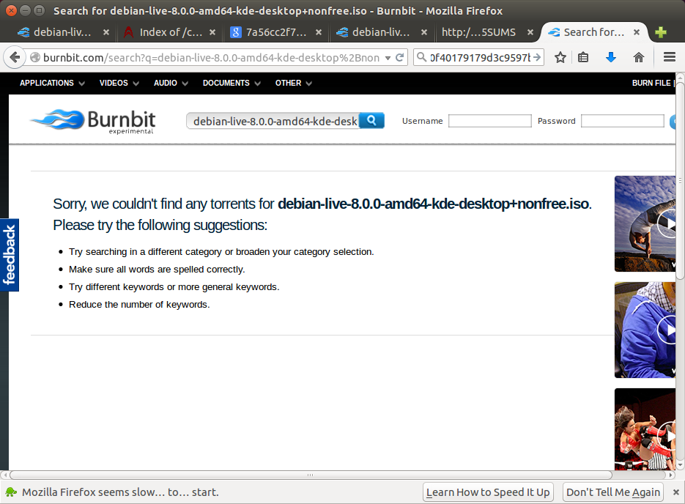
Debian 8 – Live Unofficial Non-Free
Searching burnbit.com for a BitTorrent file...

Slide 21
Debian 8 – Live Unofficial Non-Free
Obtain the MS5SUM for searching....
http://cdimage.debian.org/cdimage/unofficial/non-free/cd-including-firmware/8.0.0-live+nonfree/amd64/iso-hybrid/MD5SUMS
5c3927b13d2de3edbfc9688bec513294 debian-live-8.0.0-amd64-cinnamon-desktop+nonfree.iso
80178a95f6af3b394e8e0352632627ea debian-live-8.0.0-amd64-cinnamon-desktop+nonfree.iso.contents
c529c79a6601f76e187179359b907556 debian-live-8.0.0-amd64-cinnamon-desktop+nonfree.iso.log
c2f55d28e8c03b93a5e6bcfd4158b65f debian-live-8.0.0-amd64-cinnamon-desktop+nonfree.iso.packages
6f6afe1e79fc5c5ad841c84e0fbd69fe debian-live-8.0.0-amd64-cinnamon-desktop+nonfree.iso.zsync
7a56cc2f78f8ea90d0c78fc462f95b95 debian-live-8.0.0-amd64-gnome-desktop+nonfree.iso
80178a95f6af3b394e8e0352632627ea debian-live-8.0.0-amd64-gnome-desktop+nonfree.iso.contents
ea47b20e4bdeca82984f759287515b16 debian-live-8.0.0-amd64-gnome-desktop+nonfree.iso.log
b4231d3a6d03d1e4150921cdca458a38 debian-live-8.0.0-amd64-gnome-desktop+nonfree.iso.packages
3633d5bc8f2758187fca38a868e0eedb debian-live-8.0.0-amd64-gnome-desktop+nonfree.iso.zsync
89091f9da834910f40179179d3c9597b debian-live-8.0.0-amd64-kde-desktop+nonfree.iso
80178a95f6af3b394e8e0352632627ea debian-live-8.0.0-amd64-kde-desktop+nonfree.iso.contents
7bbad1597571d350edeeff8e30533227 debian-live-8.0.0-amd64-kde-desktop+nonfree.iso.log
0fa09e1908a9c9c430aba021f64b5ff4 debian-live-8.0.0-amd64-kde-desktop+nonfree.iso.packages
220963fa8a1eb2c4f6f29438de5f6ba9 debian-live-8.0.0-amd64-kde-desktop+nonfree.iso.zsync
7da050dc161ddfe442456c31865ac627 debian-live-8.0.0-amd64-lxde-desktop+nonfree.iso
80178a95f6af3b394e8e0352632627ea debian-live-8.0.0-amd64-lxde-desktop+nonfree.iso.contents
5b198c1fec27e7d5a3a037eedf6e3a77 debian-live-8.0.0-amd64-lxde-desktop+nonfree.iso.log
ebf182c437a3ec19576ea2e6507dcda6 debian-live-8.0.0-amd64-lxde-desktop+nonfree.iso.packages
7ac12e038b7172b1c66d515bd655161e debian-live-8.0.0-amd64-lxde-desktop+nonfree.iso.zsync
bb1e0c9a55b10833a2ee754401c7f373 debian-live-8.0.0-amd64-mate-desktop+nonfree.iso
2a75d9fe7122c591eb50a22487faedf3 debian-live-8.0.0-amd64-mate-desktop+nonfree.iso.contents
e3e763477598a1d619ccc9a63ab7f882 debian-live-8.0.0-amd64-mate-desktop+nonfree.iso.log
22332f4d1e5f6b1f5c337ae2c2726bc0 debian-live-8.0.0-amd64-mate-desktop+nonfree.iso.packages
ae970a9b849123041ba56ccf0e684d7a debian-live-8.0.0-amd64-mate-desktop+nonfree.iso.zsync
32d46af6d0321b8f6f332c35de6e73b6 debian-live-8.0.0-amd64-standard+nonfree.iso
49aaa6321c34d4660cd3c58546497d20 debian-live-8.0.0-amd64-standard+nonfree.iso.contents
627848bf431492d52a95f26901bd7fc3 debian-live-8.0.0-amd64-standard+nonfree.iso.log
ff07e75579219c4a276ec183137a60b3 debian-live-8.0.0-amd64-standard+nonfree.iso.packages
8c03a7aceba4e59f5578cc91d5d14bae debian-live-8.0.0-amd64-standard+nonfree.iso.zsync
2267bf68f5cd953b7156e83305558926 debian-live-8.0.0-amd64-xfce-desktop+nonfree.iso
80178a95f6af3b394e8e0352632627ea debian-live-8.0.0-amd64-xfce-desktop+nonfree.iso.contents
c419e23c037685fee1940633429da3ca debian-live-8.0.0-amd64-xfce-desktop+nonfree.iso.log
d385b1c4a93f5d2beb34900ff7327ffc debian-live-8.0.0-amd64-xfce-desktop+nonfree.iso.packages
7dbc2c975af36e95e9d4dffc102a5116 debian-live-8.0.0-amd64-xfce-desktop+nonfree.iso.zsync

Slide 22
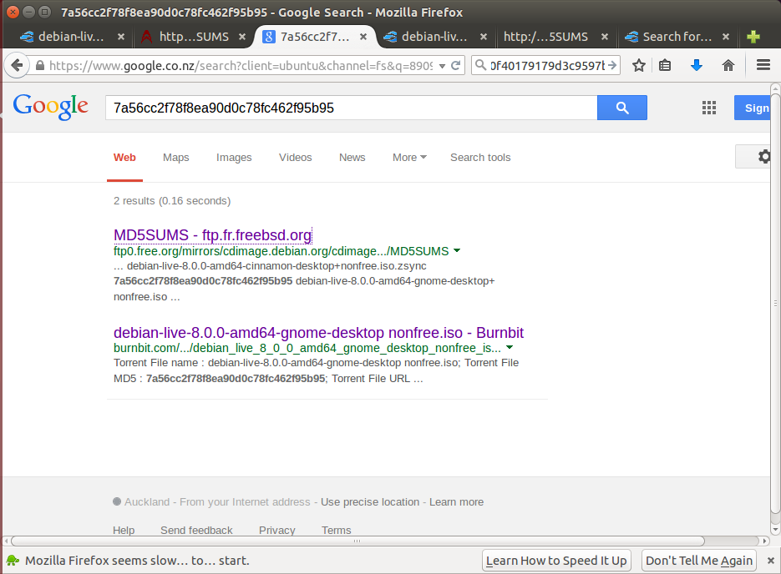
Debian 8 – Live Unofficial Non-Free
Google finds bitburn based on MD5SUM

Slide 23
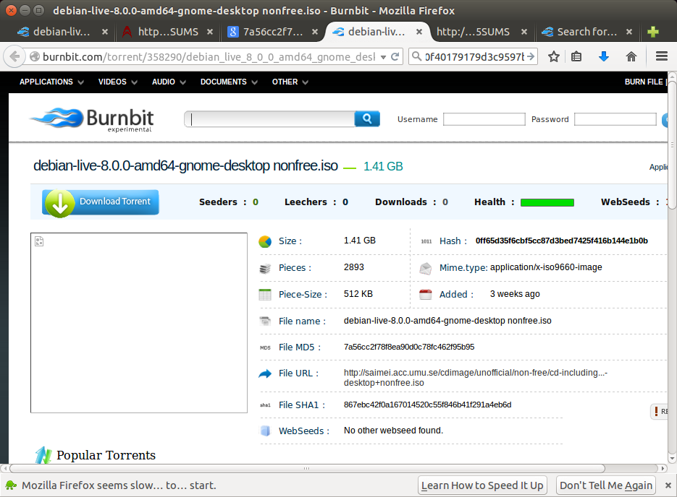
Debian 8 – Live Unofficial Non-Free bitburn.com – BitTorrent file...

Slide 24
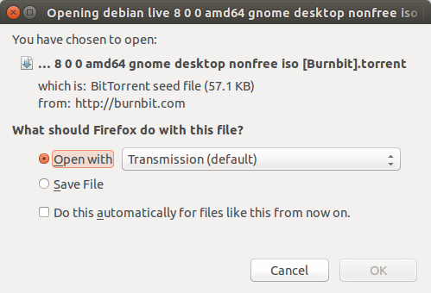
Debian 8 – Live Unofficial Non-Free bitburn.com – BitTorrent file...

Slide 25
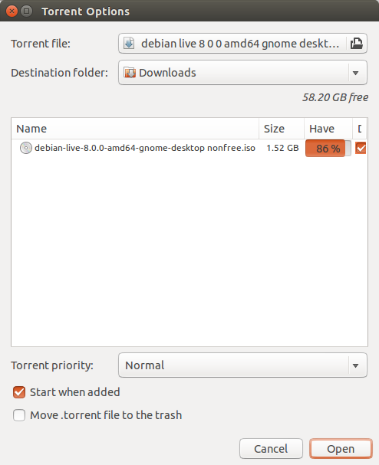
Debian 8 – Live Unofficial Non-Free bitburn.com – BitTorrent file...

Slide 26
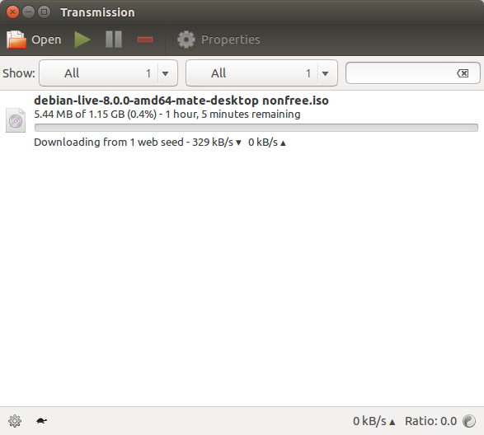
Debian 8 – Live Unofficial Non-Free bitburn.com – BitTorrent file...

Slide 27
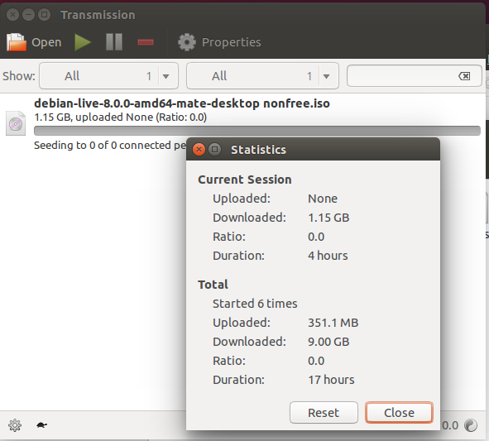
Debian 8 – Live Unofficial Non-Free bitburn.com – BitTorrent file...

Slide 28
Debian 8 – Live Unofficial Non-Free
Using dd to copy iso file to USB stick
$ sudo dd if="debian-live-8.0.0-amd64-gnome-desktop nonfree.iso" of=/dev/sdc bs=4M; sync
[sudo] password for ian:
361+1 records in
361+1 records out
1516290048 bytes (1.5 GB) copied, 216.358 s, 7.0 MB/s

Slide 29
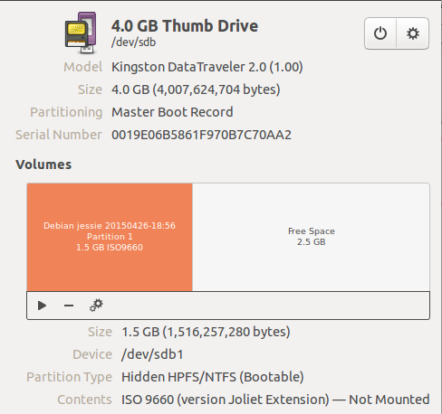
Debian 8 – Live Unofficial Non-Free
USB stick

Slide 30
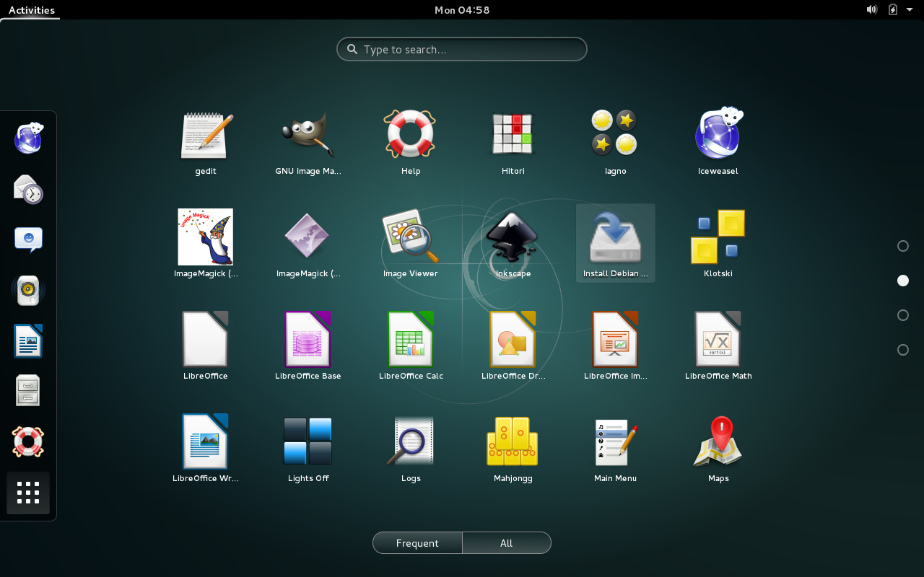
Debian 8 – Live Unofficial Non-Free
USB stick Install to Disk

Slide 31
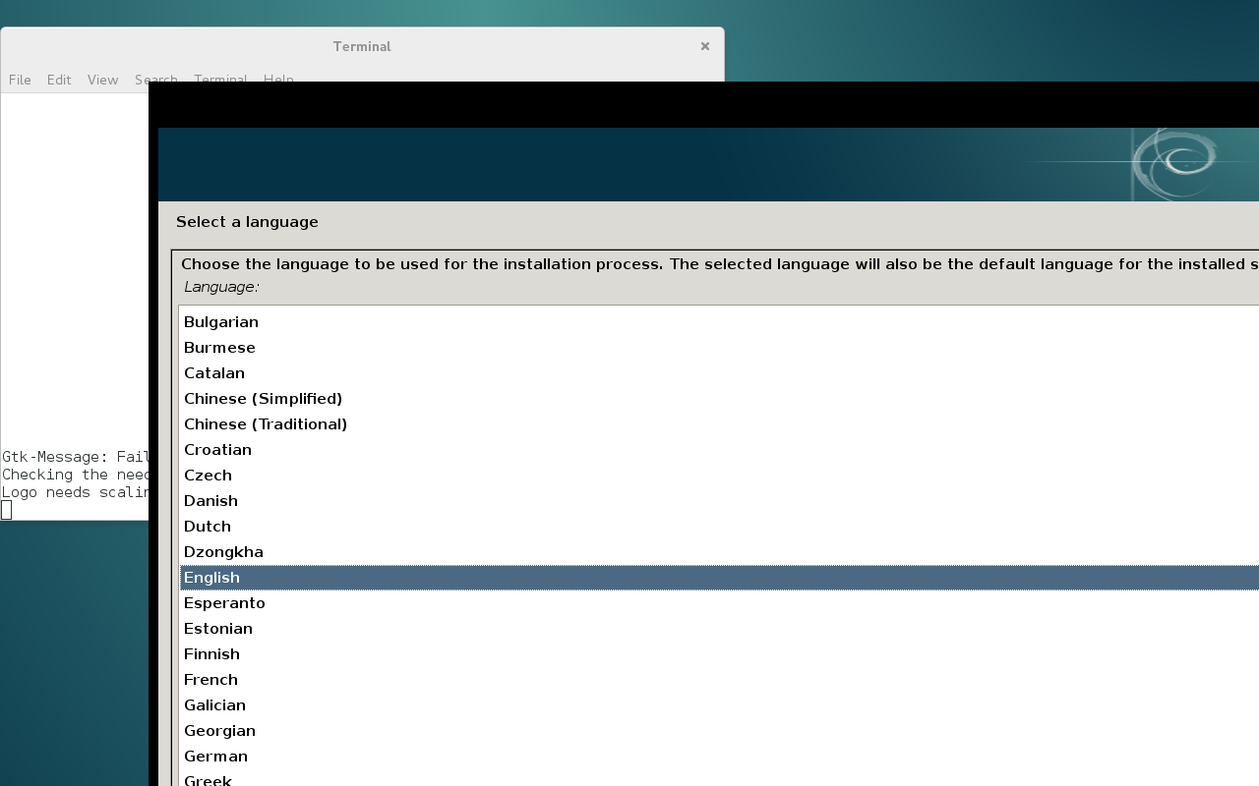
Debian 8 – Live Unofficial Non-Free
USB stick – Install to Disk

Slide 32
end

